Slide 1


Slide 2
What is CloudPlay?
Youtube Music streaming app.
Minimalistic.
Aimed to be quick and easy to use.

Slide 3
What sets it apart?
Straight forward UI.
No non-essential feature cluttering the app.
Convenient to use in daily life.

Slide 4
Target audience
General users who listen to music on daily basis.
Users who like a more lightweight option of online-based
audio player.

Slide 5
Main features
Scroll based UI.
Videos from Youtube.
Search function.
Save and delete songs to favorite.

Slide 6
Main libraries and APIs
Google APIs: for sign-in and authentication.
Youtube data APIs: for retrieving video information.
Youtube-dl server: for getting direct link from Youtube video IDs.
Picasso: used for image loading and caching.
Retrofit: used for http calls on custom servers.
Pymongo and flask: used for back-end database manipulation and management

Slide 7
Cloud Services
mLab: host MongoDB database for list of favorite videos.
Uptimer Robot: used to ping servers periodically so that it doesn’t go to sleep.
Heroku: For hosting custom servers.

Slide 8
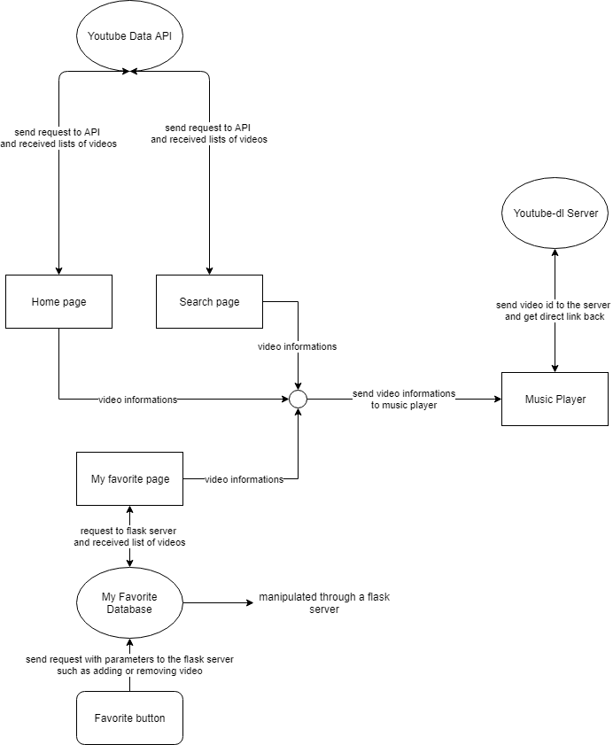
General program flow

Slide 9
App preview

Slide 10
Development obstacles
Changes of main APIs used from SoundCloud to Spotify and, eventually, Youtube.
Reason:
SoundCloud shut down registration for their API.
Spotify limits some functions to paid user.

Slide 11
Development obstacles
Choosing to use external server for media files instead of Youtube official library.
Reason:
Youtube official media library comes with its own player, which can be limiting in some cases.
Getting direct link to file allow more manipulation and control over the music.

Slide 12
Conclusion
Why use it?
able to listen to vast variety of music from Youtube on the go without having to download it.
Easy to use UI allows user to focus on listening to the music instead of the app itself.

